Slide 1



Definitions
Regular Expression (REGEX): is a sequence of symbols and characters expressing a string or pattern to be searched for within a longer piece of text.
Nondeterministic finite automaton (NFA) and Deterministic finite automaton (DFA):
NFA and DFA are similar, a state machine consisting of states and transitions that can either accept or reject a finite string. We must use circles to represent states, and directed arrows to represent transitions.
Our REGEX:
$\left(− | e\right)$(0|([1-9][0-9]*) $((.\left[0−9\right]{\left[0−9\right]}^{∗})|e)$
Notes:
Hello there!
In this video I will lead you into the world of languages handling tools!
First, meet with the regular expressions! REGEX is a sequence of symbols and characters expressing a string or pattern to be searched for within a longer piece of text.
REGEX is equivalent with N-F-A and D-F-A. All of these practical tools we can create rules which can determine a language. This tools have their own barriers, they can’t describe all existing languages, but they are very good starting point to step into this field!
See our REGEX, which describes the real numbers! Go through onebyte one how to interpret it and create N-F-A and D-F-A! At the and we we make a program code in Python too!

Slide 2

$\left(− | e\right)$(0|([1-9][0-9]*) $((.\left[0−9\right]{\left[0−9\right]}^{∗})|e)$
-
e
Notes:
Let’s get started with the first part of our regular expression!
We get a minus symbole or an empty string. Make the automat for this expression!
First need an initial state, which always marked as a circle with two lines, as you can see on the screen.
With a minus symbol we go to an acceptable state, wich marked with this double circle.
Next one is the automat of the empty string. We have an initial state as before and with an empty string step to the acceptance state.
So now, we have to combine them together!

Slide 3
$\left(− | e\right)$(0|([1-9][0-9]*) $((.\left[0−9\right]{\left[0−9\right]}^{∗})|e)$
e
-
e
e
Notes:
Remove the old initial state.
Get a new initial state.
Connect the initial state with the previous state with an empty string transition.

Slide 4

$\left(− | e\right)$(0|([1-9][0-9]*) $((.\left[0−9\right]{\left[0−9\right]}^{∗})|e)$
e
-
e
e
0
0-9
1-9
Notes:
It’s ready, go to the next part!
Takes 0 or different amount of numbers.
Make the automat whoch accepts the 0, it’s easy we see this kind of problem before.
Next on is a little bit harder. The expression tells that, we accept any number between 1-9, but only one number.
The asterix means that after this, can we accpet any number from 0 to 9 and the quantity of the number not specified, it can be 0 digit, or thousands of it, just infinite.
So our automat first get one digit from 1 to 9 and it’s a valid number, we are in an acceptance state. If we get numbers again, we will stay this state. This is what the automat describes in a visual way.

Slide 5
$\left(− | e\right)$(0|([1-9][0-9]*) $((.\left[0−9\right]{\left[0−9\right]}^{∗})|e)$
e
-
e
e
0
e
0-9
e
1-9
Notes:
Next step is not a new one, we creat the „or” relationship betwen our automats. Create a brand new initial state and make connection with empty strings with the old state. We are done with this part!

Slide 6
$\left(− | e\right)$(0|([1-9][0-9]*) $((.\left[0−9\right]{\left[0−9\right]}^{∗})|e)$
e
-
e
e
0
e
0-9
e
1-9
Notes:
Take a look at the last part of our expression! It is very similar to the previous one. We have to get a dot and a number, it’s obligatory!
After this arbitrary amount of number.

Slide 7

$\left(− | e\right)$(0|([1-9][0-9]*) $((.\left[0−9\right]{\left[0−9\right]}^{∗})|e)$
e
-
e
0-9
e
.
0-9
0
e
e
0-9
e
1-9
Notes:
Take a look at the last part of our expression! It is very similar to the previous one. We have to get a dot and a number, it’s obligatory!
After this arbitrary amount of number.
First an initail state, and with a dot go an inner state, which is not acceptance! Now get a number from 0 to 9. This will be a valid number so our machine accept it.
From now we can accept any quantity of numbers, so if we are in this state we will stay here with any number from 0 to 9.
The automat of empty string acceptance machine is simple.

Slide 8
$\left(− | e\right)$(0|([1-9][0-9]*) $((.\left[0−9\right]{\left[0−9\right]}^{∗})|e)$
e
-
e
0-9
e
.
0-9
e
0
e
e
e
0-9
e
1-9
Notes:
To combine the automats together, make a new initial state, and transitions with empty string into the old statrting positions.

Slide 9
$\left(− | e\right)$(0|([1-9][0-9]*) $((.\left[0−9\right]{\left[0−9\right]}^{∗})|e)$
e
-
e
0-9
e
.
0-9
e
0
e
e
e
0-9
e
1-9
Notes:
All three part are ready, now make a fusion of them!

Slide 10

$\left(− | e\right)$(0|([1-9][0-9]*) $((.\left[0−9\right]{\left[0−9\right]}^{∗})|e)$
e
-
I.
e
e
I.
II.
III.
0-9
0
e
-
0
.
0-9
II.
0-9
e
e
e
e
e
0-9
e
1-9
e
e
e
e
e
e
1-9
e
0-9
.
0-9
e
III.
e
e
Notes:
Stick them together!

Slide 11
NFA is ready, now convert it into DFA
0-9
2
3
7
8
12
13
-
0
.
0-9
14
e
e
e
11
e
1
e
6
0-9
e
e
e
e
e
1-9
e
e
15
16
4
5
9
10
Notes:
We are ready to convert our N-F-A into a D-F-A.
Give a uniqe identifier to all state 1 to 16!
After this, check for all state, which other state are available from the starting position with an empty string.
E-1, means the position number 1, have a set with itself, (the actual state always available with an e), state 2, state 4, state 5, state 6, state7 and state 9.
And so on check all other state!
Position number 2, is only 2 because noe of other position available with e.

Slide 12
NFA is ready, now convert it into DFA
0-9
2
3
7
8
12
13
-
0
.
0-9
14
e
e
e
11
e
1
e
6
0-9
e
e
e
e
e
1-9
e
e
15
16
4
5
9
10

Slide 13
NFA is ready, now convert it into DFA
0-9
2
3
7
8
12
13
-
0
.
0-9
14
e
e
e
11
e
1
e
6
0-9
e
e
e
e
e
1-9
e
e
15
16
4
5
9
10

Slide 14
NFA is ready, now convert it into DFA
0-9
2
3
7
8
12
13
-
0
.
0-9
14
e
e
e
11
e
1
e
6
0-9
e
e
e
e
e
1-9
e
e
15
16
4
5
9
10

Slide 15
NFA is ready, now convert it into DFA
0-9
2
3
7
8
12
13
-
0
.
0-9
14
e
e
e
11
e
1
e
6
0-9
e
e
e
e
e
1-9
e
e
15
16
4
5
9
10

Slide 16
NFA is ready, now convert it into DFA
0-9
2
3
7
8
12
13
-
0
.
0-9
14
e
e
e
11
e
1
e
6
0-9
e
e
e
e
e
1-9
e
e
15
16
4
5
9
10

Slide 17
NFA is ready, now convert it into DFA
0-9
2
3
7
8
12
13
-
0
.
0-9
14
e
e
e
11
e
1
e
6
0-9
e
e
e
e
e
1-9
e
e
15
16
4
5
9
10

Slide 18
NFA is ready, now convert it into DFA
0-9
2
3
7
8
12
13
-
0
.
0-9
14
e
e
e
11
e
1
e
6
0-9
e
e
e
e
e
1-9
e
e
15
16
4
5
9
10

Slide 19
NFA is ready, now convert it into DFA
0-9
2
3
7
8
12
13
-
0
.
0-9
14
e
e
e
11
e
1
e
6
0-9
e
e
e
e
e
1-9
e
e
15
16
4
5
9
10

Slide 20
NFA is ready, now convert it into DFA
0-9
2
3
7
8
12
13
-
0
.
0-9
14
e
e
e
11
e
1
e
6
0-9
e
e
e
e
e
1-9
e
e
15
16
4
5
9
10

Slide 21
NFA is ready, now convert it into DFA
0-9
2
3
7
8
12
13
-
0
.
0-9
14
e
e
e
11
e
1
e
6
0-9
e
e
e
e
e
1-9
e
e
15
16
4
5
9
10

Slide 22
NFA is ready, now convert it into DFA
0-9
2
3
7
8
12
13
-
0
.
0-9
14
e
e
e
11
e
1
e
6
0-9
e
e
e
e
e
1-9
e
e
15
16
4
5
9
10

Slide 23
NFA is ready, now convert it into DFA
0-9
2
3
7
8
12
13
-
0
.
0-9
14
e
e
e
11
e
1
e
6
0-9
e
e
e
e
e
1-9
e
e
15
16
4
5
9
10

Slide 24
NFA is ready, now convert it into DFA
E(1) = {1, 2, 4, 5, 6, 7, 9}
0-9
2
3
7
8
12
13
-
0
.
0-9
14
e
e
e
11
e
1
e
6
0-9
e
e
e
e
e
1-9
e
e
15
16
4
5
9
10
Notes:
We can go with empty string to 1 / 2 / 4 / 5 / 6 / 7 / 9.

Slide 25
NFA is ready, now convert it into DFA
E(1) = {1, 2, 4, 5, 6, 7, 9}
E(2) = {2}
0-9
2
3
7
8
12
13
-
0
.
0-9
14
e
e
e
11
e
1
e
6
0-9
e
e
e
e
e
1-9
e
e
15
16
4
5
9
10
Notes:
We can go with empty string only to 2.

Slide 26
NFA is ready, now convert it into DFA
E(1) = {1, 2, 4, 5, 6, 7, 9}
E(2) = {2}
0-9
2
3
7
8
12
13
-
0
.
0-9
14
e
e
e
11
e
1
e
6
0-9
e
e
e
e
e
1-9
e
e
15
16
4
5
9
10

Slide 27
NFA is ready, now convert it into DFA
E(1) = {1, 2, 4, 5, 6, 7, 9}
E(2) = {2}
0-9
2
3
7
8
12
13
-
0
.
0-9
14
e
e
e
11
e
1
e
6
0-9
e
e
e
e
e
1-9
e
e
15
16
4
5
9
10

Slide 28
NFA is ready, now convert it into DFA
E(1) = {1, 2, 4, 5, 6, 7, 9}
E(2) = {2}
0-9
2
3
7
8
12
13
-
0
.
0-9
14
e
e
e
11
e
1
e
6
0-9
e
e
e
e
e
1-9
e
e
15
16
4
5
9
10

Slide 29
NFA is ready, now convert it into DFA
E(1) = {1, 2, 4, 5, 6, 7, 9}
E(2) = {2}
0-9
2
3
7
8
12
13
-
0
.
0-9
14
e
e
e
11
e
1
e
6
0-9
e
e
e
e
e
1-9
e
e
15
16
4
5
9
10

Slide 30
NFA is ready, now convert it into DFA
E(1) = {1, 2, 4, 5, 6, 7, 9}
E(2) = {2}
0-9
2
3
7
8
12
13
-
0
.
0-9
14
e
e
e
11
e
1
e
6
0-9
e
e
e
e
e
1-9
e
e
15
16
4
5
9
10

Slide 31
NFA is ready, now convert it into DFA
E(1) = {1, 2, 4, 5, 6, 7, 9}
E(2) = {2}
0-9
2
3
7
8
12
13
-
0
.
0-9
14
e
e
e
11
e
1
e
6
0-9
e
e
e
e
e
1-9
e
e
15
16
4
5
9
10

Slide 32
NFA is ready, now convert it into DFA
E(1) = {1, 2, 4, 5, 6, 7, 9}
E(2) = {2}
E(3) = {3, 6, 7, 9}
0-9
2
3
7
8
12
13
-
0
.
0-9
14
e
e
e
11
e
1
e
6
0-9
e
e
e
e
e
1-9
e
e
15
16
4
5
9
10
Notes:
We can go with empty string to 3 / 6 / 7 / 9.

Slide 33
NFA is ready, now convert it into DFA
E(1) = {1, 2, 4, 5, 6, 7, 9}
E(2) = {2}
E(3) = {3, 6, 7, 9}
E(4) = {4, 5, 6, 7, 9}
E(5) = {5, 6, 7, 9}
E(6) = {6, 7, 9}
E(7) = {7}
E(8) = {8, 11, 12, 15,16}
E(9) = {9}
E(10) = {10, 11, 12, 15, 16}
E(11) = {11, 12, 15, 16}
E(12) = {12}
E(13) = {13}
E(14) = {14}
E(15) = {15, 16}
E(16) = {16}
0-9
2
3
7
8
12
13
-
0
.
0-9
14
e
e
e
11
e
1
e
6
0-9
e
e
e
e
e
1-9
e
e
15
16
4
5
9
10
Notes:
If you play this rule all other state you will get this results:

Slide 34
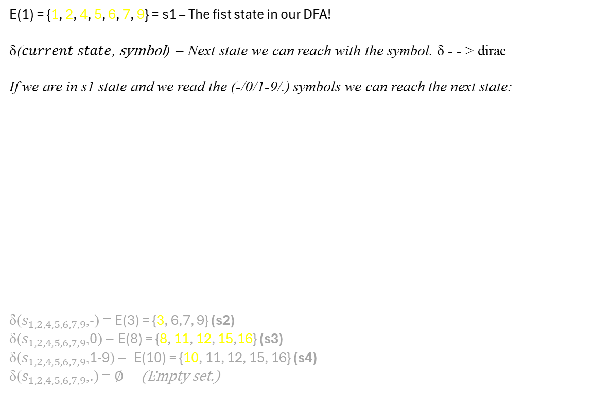
NFA is ready, now convert it into DFA
E(1) = {1, 2, 4, 5, 6, 7, 9}
E(2) = {2}
E(3) = {3, 6, 7, 9}
E(4) = {4, 5, 6, 7, 9}
E(5) = {5, 6, 7, 9}
E(6) = {6, 7, 9}
E(7) = {7}
E(8) = {8, 11, 12, 15,16}
E(9) = {9}
E(10) = {10, 11, 12, 15, 16}
E(11) = {11, 12, 15, 16}
E(12) = {12}
E(13) = {13}
E(14) = {14}
E(15) = {15, 16}
E(16) = {16}
<-- Let’s check the sets! The question is: is there any new state in it? If yes, that will be our new merged state in the DFA!
E(1) = {1, 2, 4, 5, 6, 7, 9} = s1 – The fist state in our DFA!
δ($current state$, symbol) = Next state we can reach with the symbol. δ - - > dirac
If we are in s1 state and we read the (-/0/1-9/.) symbols we can reach the next state:
δ($s_{1,2,4,5,6,7,9}$,-) = E(3) = {3, 6,7, 9} (s2)
δ($s_{1,2,4,5,6,7,9}$,0) = E(8) = {8, 11, 12, 15,16} (s3)
δ($s_{1,2,4,5,6,7,9}$,1-9) = E(10) = {10, 11, 12, 15, 16} (s4)
δ($s_{1,2,4,5,6,7,9}$,.) = ∅ (Empty set.)
0-9
2
3
7
8
12
13
-
0
.
0-9
14
e
e
11
e
1
e
6
e
0-9
e
e
e
e
e
e
1-9
e
9
10
15
16
4
5
s1 = [E(1)+E(2)+E(4)+E(5)+E(6)+E(7)+E(9)]
Notes:
Okay, now we have to check into which positions can we go if we read the different symboles. First, with the minus symbole, we will reach only E3, what will be our s2 in the DFA, because E3 contains more formerly unused states from the NFA.
With zero we reach E8, because 8-11-12-15-16 not used states before, we can merge them together into one state.
With number 1-9 we reach E10, and E10 is the s4 state in the DFA, since E10 is not used before. With the dot we can’t move so as a result is an emtpy set.

Slide 35
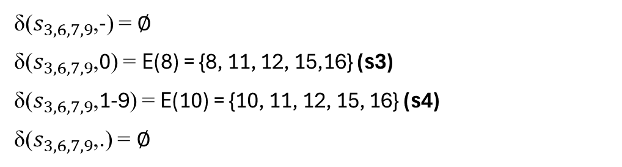
NFA is ready, now convert it into DFA
E(1) = {1, 2, 4, 5, 6, 7, 9}
E(2) = {2}
E(3) = {3, 6, 7, 9}
E(4) = {4, 5, 6, 7, 9}
E(5) = {5, 6, 7, 9}
E(6) = {6, 7, 9}
E(7) = {7}
E(8) = {8, 11, 12, 15,16}
E(9) = {9}
E(10) = {10, 11, 12, 15, 16}
E(11) = {11, 12, 15, 16}
E(12) = {12}
E(13) = {13}
E(14) = {14}
E(15) = {15, 16}
E(16) = {16}
0-9
2
3
7
8
12
13
-
0
.
0-9
14
e
e
11
e
1
e
6
e
0-9
e
e
e
e
e
e
1-9
e
9
10
15
16
4
5
δ($s_{3,6,7,9}$,-) = ∅
δ($s_{3,6,7,9}$,0) = E(8) = {8, 11, 12, 15,16} (s3)
δ($s_{3,6,7,9}$,1-9) = E(10) = {10, 11, 12, 15, 16} (s4)
δ($s_{3,6,7,9}$,.) = ∅
s2 = [E(3)+E(6)+E(7)+E(9)]
Notes:
As I mentioned, E3 is equvivalent with s2. Let’s see the behavior our automat if we read the symboles.
Minues? Nowhere to go.
Zero? It leads to E8, it is our DFA s3.
Numbers above 0? Jump to E10, in DFA is it s4, don’t forget it!
Last, the dot, same as first, no destination.

Slide 36
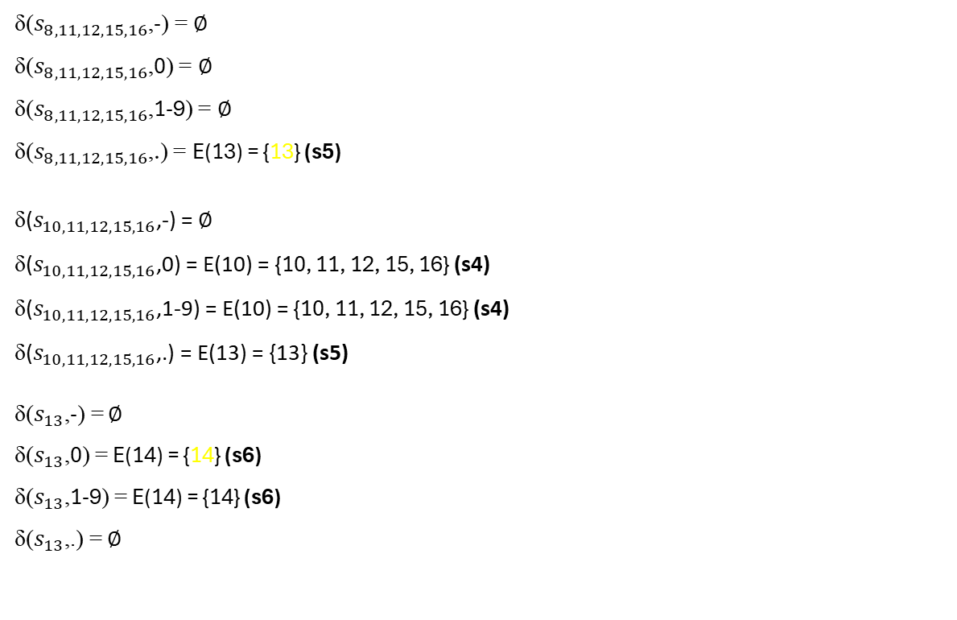
NFA is ready, now convert it into DFA
E(1) = {1, 2, 4, 5, 6, 7, 9}
E(2) = {2}
E(3) = {3, 6, 7, 9}
E(4) = {4, 5, 6, 7, 9}
E(5) = {5, 6, 7, 9}
E(6) = {6, 7, 9}
E(7) = {7}
E(8) = {8, 11, 12, 15,16}
E(9) = {9}
E(10) = {10, 11, 12, 15, 16}
E(11) = {11, 12, 15, 16}
E(12) = {12}
E(13) = {13}
E(14) = {14}
E(15) = {15, 16}
E(16) = {16}
<-- Let’s check the sets! The question is: is there any new state in it? If yes, that will be our new merged state in the DFA!
δ($s_{8,11,12,15,16}$,-) = ∅
δ($s_{8,11,12,15,16}$,0) = ∅
δ($s_{8,11,12,15,16}$,1-9) = ∅
δ($s_{8,11,12,15,16}$,.) = E(13) = {13} (s5)
δ($s_{10,11,12,15,16}$,-) = ∅
δ($s_{10,11,12,15,16}$,0) = E(10) = {10, 11, 12, 15, 16} (s4)
δ($s_{10,11,12,15,16}$,1-9) = E(10) = {10, 11, 12, 15, 16} (s4)
δ($s_{10,11,12,15,16}$,.) = E(13) = {13} (s5)
δ($s_{13}$,-) = ∅
δ($s_{13}$,0) = E(14) = {14} (s6)
δ($s_{13}$,1-9) = E(14) = {14} (s6)
δ($s_{13}$,.) = ∅
s3 [E(8)+E(11)+E(12)+E(15)+E(16)]
s4 [E(10)+E(11)+E(12)+E(15)+E(16)]
s5 [E(13)]
Notes:
Use this logic for all other states, and get the result what is on the display! It’s quite easy to find out!

Slide 37
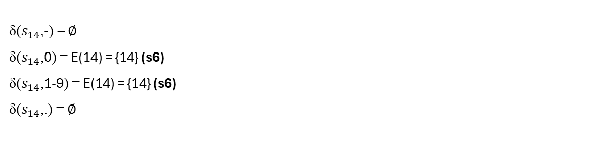
NFA is ready, now convert it into DFA
E(1) = {1, 2, 4, 5, 6, 7, 9}
E(2) = {2}
E(3) = {3, 6, 7, 9}
E(4) = {4, 5, 6, 7, 9}
E(5) = {5, 6, 7, 9}
E(6) = {6, 7, 9}
E(7) = {7}
E(8) = {8, 11, 12, 15,16}
E(9) = {9}
E(10) = {10, 11, 12, 15, 16}
E(11) = {11, 12, 15, 16}
E(12) = {12}
E(13) = {13}
E(14) = {14}
E(15) = {15, 16}
E(16) = {16}
<-- Let’s check the sets! The question is: is there any new state in it? If yes, that will be our new merged state in the DFA!
δ($s_{14}$,-) = ∅
δ($s_{14}$,0) = E(14) = {14} (s6)
δ($s_{14}$,1-9) = E(14) = {14} (s6)
δ($s_{14}$,.) = ∅
s6 [E(14)]
Now the DFA has 6 state, but in the state transitions you can see a lot of empty sets (∅. It means that, there is no state for that state and symbol combination. That’s why an extra s7 state is needed to handle this cases.
s3 [E(8)+E(11)+E(12)+E(15)+E(16)]
s4 [E(10)+E(11)+E(12)+E(15)+E(16)]
s6 [E(14)]
Notes:
Last, but not least, s6!
If you remember we have cases when the result was emtpy. To handle those situations, make an extra state, s7. If the reading goes wrong, and there is no possibility to get a valid number, the automat step into this state, and there will be no chance to accept anything which come.
Other question! What will be an acceptance state in the D-F-A? It’s easy! All states, which contain acceptance state from the N-F-A!
In the N-F-A the E8, E10, E14 and E16 were acceptance. So all states in the D-F-A will be an end state which contains one or more from these states, so:
S3, S4 and S6!

Slide 38
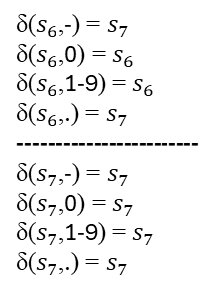
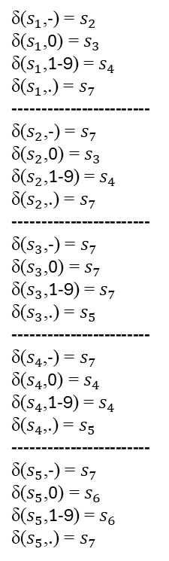
DFA:
0-9
δ($s_{6}$,-) = $s_{7}$
δ($s_{6}$,0) = $s_{6}$
δ($s_{6}$,1-9) = $s_{6}$
δ($s_{6}$,.) = $s_{7}$
------------------------
δ($s_{7}$,-) = $s_{7}$
δ($s_{7}$,0) = $s_{7}$
δ($s_{7}$,1-9) = $s_{7}$
δ($s_{7}$,.) = $s_{7}$
δ($s_{1}$,-) = $s_{2}$
δ($s_{1}$,0) = $s_{3}$
δ($s_{1}$,1-9) = $s_{4}$
δ($s_{1}$,.) = $s_{7}$
------------------------
δ($s_{2}$,-) = $s_{7}$
δ($s_{2}$,0) = $s_{3}$
δ($s_{2}$,1-9) = $s_{4}$
δ($s_{2}$,.) = $s_{7}$
------------------------
δ($s_{3}$,-) = $s_{7}$
δ($s_{3}$,0) = $s_{7}$
δ($s_{3}$,1-9) = $s_{7}$
δ($s_{3}$,.) = $s_{5}$
------------------------
δ($s_{4}$,-) = $s_{7}$
δ($s_{4}$,0) = $s_{4}$
δ($s_{4}$,1-9) = $s_{4}$
δ($s_{4}$,.) = $s_{5}$
------------------------
δ($s_{5}$,-) = $s_{7}$
δ($s_{5}$,0) = $s_{6}$
δ($s_{5}$,1-9) = $s_{6}$
δ($s_{5}$,.) = $s_{7}$
.
s4
s5
1-9
s2
. -
.
1-9
-
0-9
0
. -
0
0-9
s1
s3
s6
- 0-9
. -
-
s7
.
. - 0-9
Notes:
Replace all E states with their DFA adequate form, with the s states. Check one by one what happned if we read the symboles in the different states.
We are in s1.
With minus go to s2.
With zero go to s3.
With numbers go to s4.
Dot is ruins everything so we have to in s7.
Let’s check s2!
Minus and dot are leads to s7.
With zero step to s3! Do not forget this is an acceptance state, so double circled!
With number go to s4. Like s3 it is an acceptance state!
When we stay in s3, we accept the number (or word) what we get, but we can go forward!
With minus, zero, and other numbers step to s7.
Only with a dot can we go to s5.
In s4, with the minus go to s7.
With numbers zero to nine stay in s4.
With dot step to s5.
In s5, minus and dot is problematic, throw us into s7.
The numbers are our friends here, leads to s6, acceptance state.
In s6, the situation is the same as before.
In the last state, as I mentioned before, doesn’t matter what symbole comes, we can’t get a valid number, so we stay in s7 in all cases!
Just look at our D-F-A how grow it! Ist nice, isn’t it?

